Slide 1
Researching Project MongoDB and Mobile App
‘ Week1 Report ’
Lecturer: Mr. HEL Chanthan
Prepared by Mr. VANNAK Sovannroth
2019-2020

Slide 2
Outline
Planning for First Month.
Installation MongoDB (Shell and Compass)
Connect localhost between Shell and Compass.(Locally)
Performing CRUD (Create, Read, Update, Delete) on Mongo Shell and MongoDB Compass.
Creating MongoDB Atlas account and Projects.
Connect MongoDB Atlas to Mongo Shell or MongoDB Compass, and Driver (Node.js).(Cloud)
Installation Visual Studio Code .
Connecting Node.js to MongoDB Cluster. (Cloud)
Connecting sample Backend to MongoDB Cluster and storing Products in the Database.
PAGE 01

Slide 3
Planning for First Month
Activity (Start on 06.08.2020) | Thursday (Presentation day) | Friday | Monday | Tuesday | Wednesday (Meeting day)
Week 1 | Installation MongoDB (Shell and Compass) and connect localhost between Shell and Compass.(Locally) | Performing CRUD (Create, Read, Update, Delete) on Mongo Shell and MongoDB Compass. | Creating MongoDB Atlas account and connect it to Mongo Shell or MongoDB Compass, and Driver (Node.js).(Cloud) | Installation Visual Studio Code and connect driver to MongoDB Atlas.(Cloud) | Connecting sample Backend to MongoDB Cluster and storing Products in the Database.
Week 2 | Connecting driver to Mongo Shell.(Locally) | Starting to build sample backend connect with and without MongoDB Atlas. | Build creating, editing and deleting Products on server. | Transmitting and fetching data to/from the Database. | Creating Login and Signup. (Email and password)
Week 3 | Adding Users connect to database. | Starting to build backend for project. | Creating Login and Signup. | User management: • Create new user • Reset user password • Delete and edit user | Manage new category: • Create new category • Edit and delete exiting categories.
Week 4 | Manage news: • Post news • Edit news • Delete news | Manage Info: • Logo • Name • Contact info • Map • Social | Create Dashboard | Manage Calculate: • Addition • Subtraction • Multiplication • Division | Get data from Sensors and Calculate.
PAGE 02

Slide 4
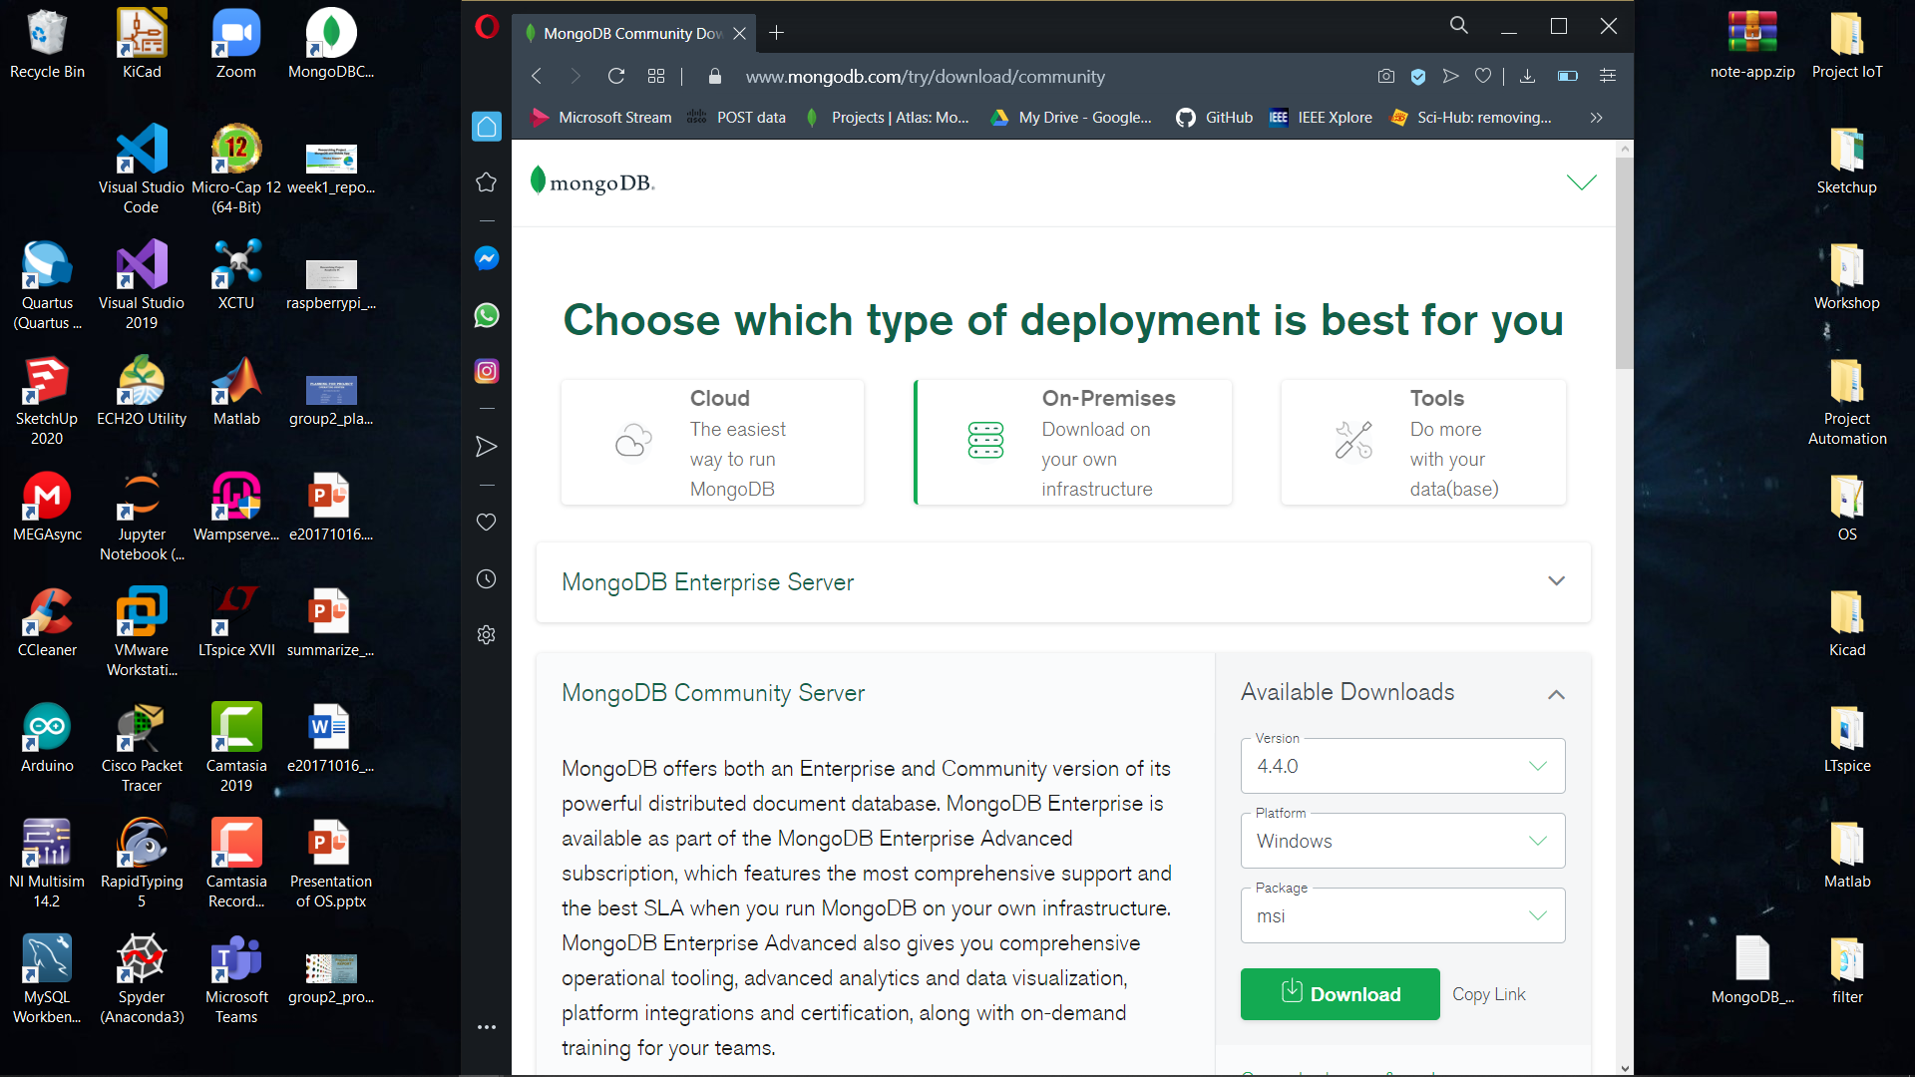
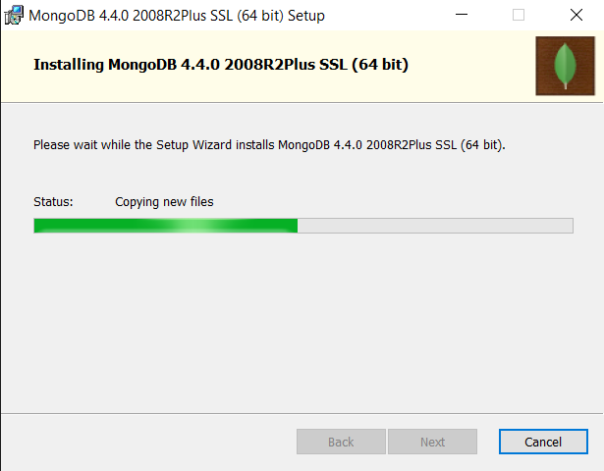
Installation MongoDB (Shell and Compass)
PAGE 03

Slide 5
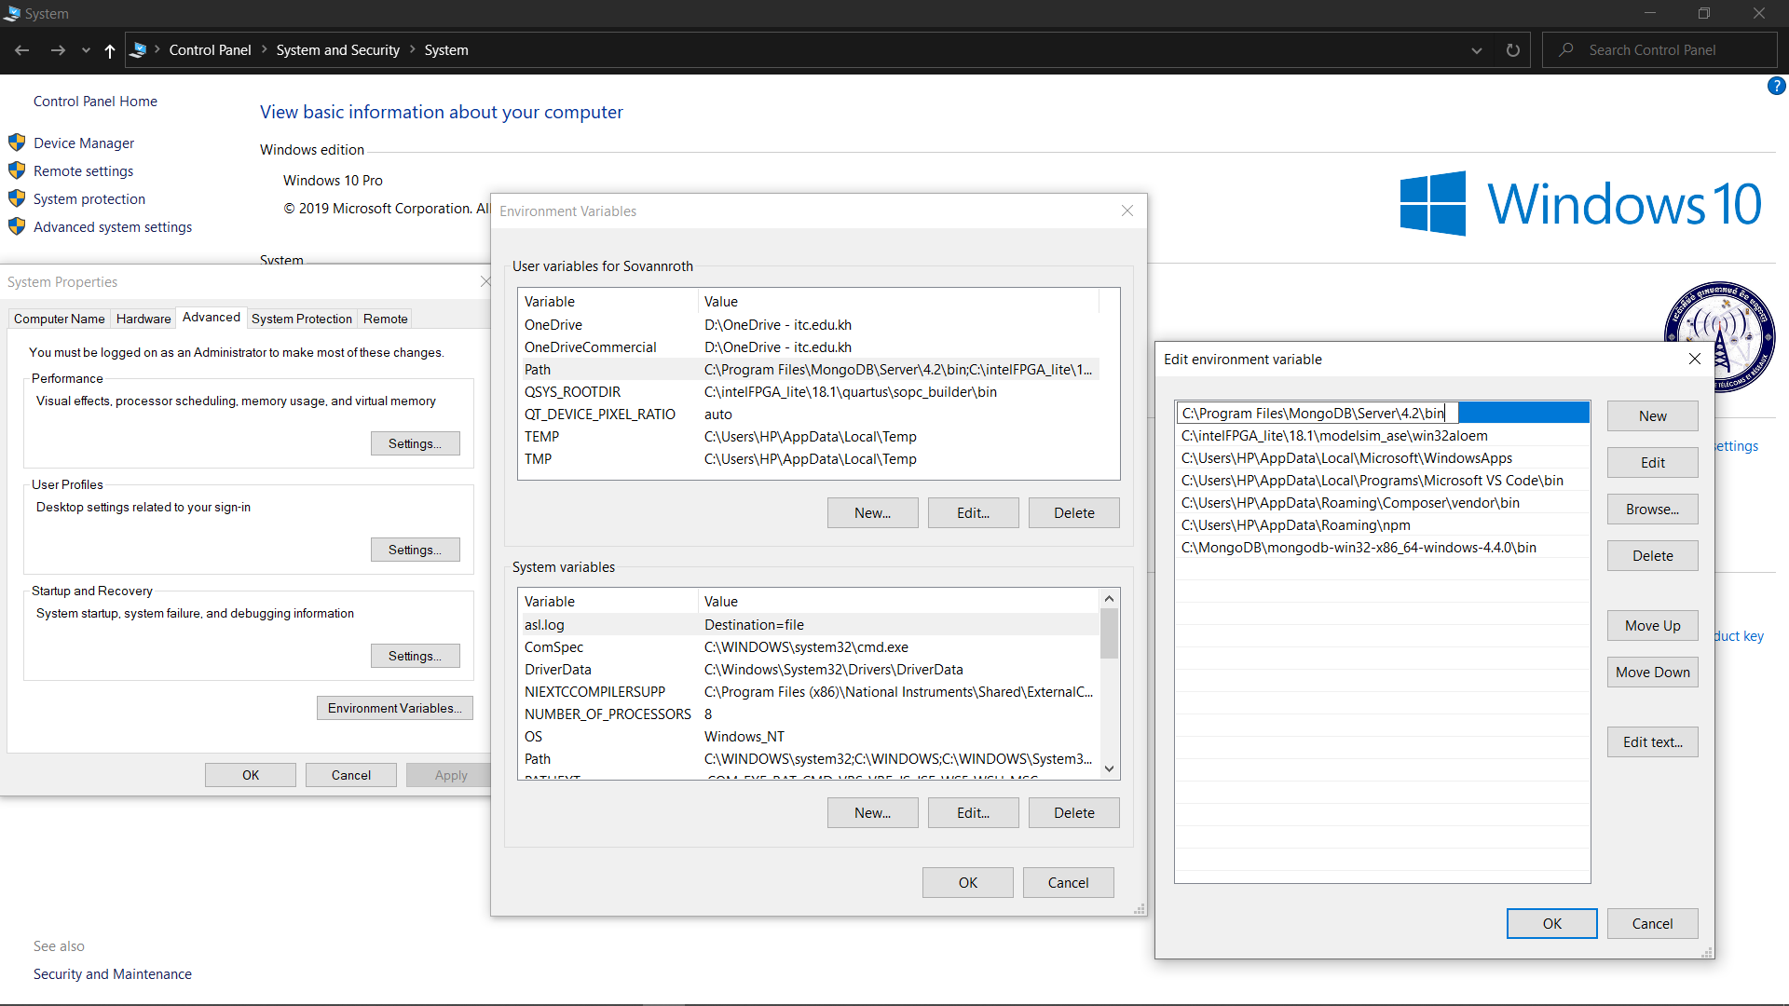
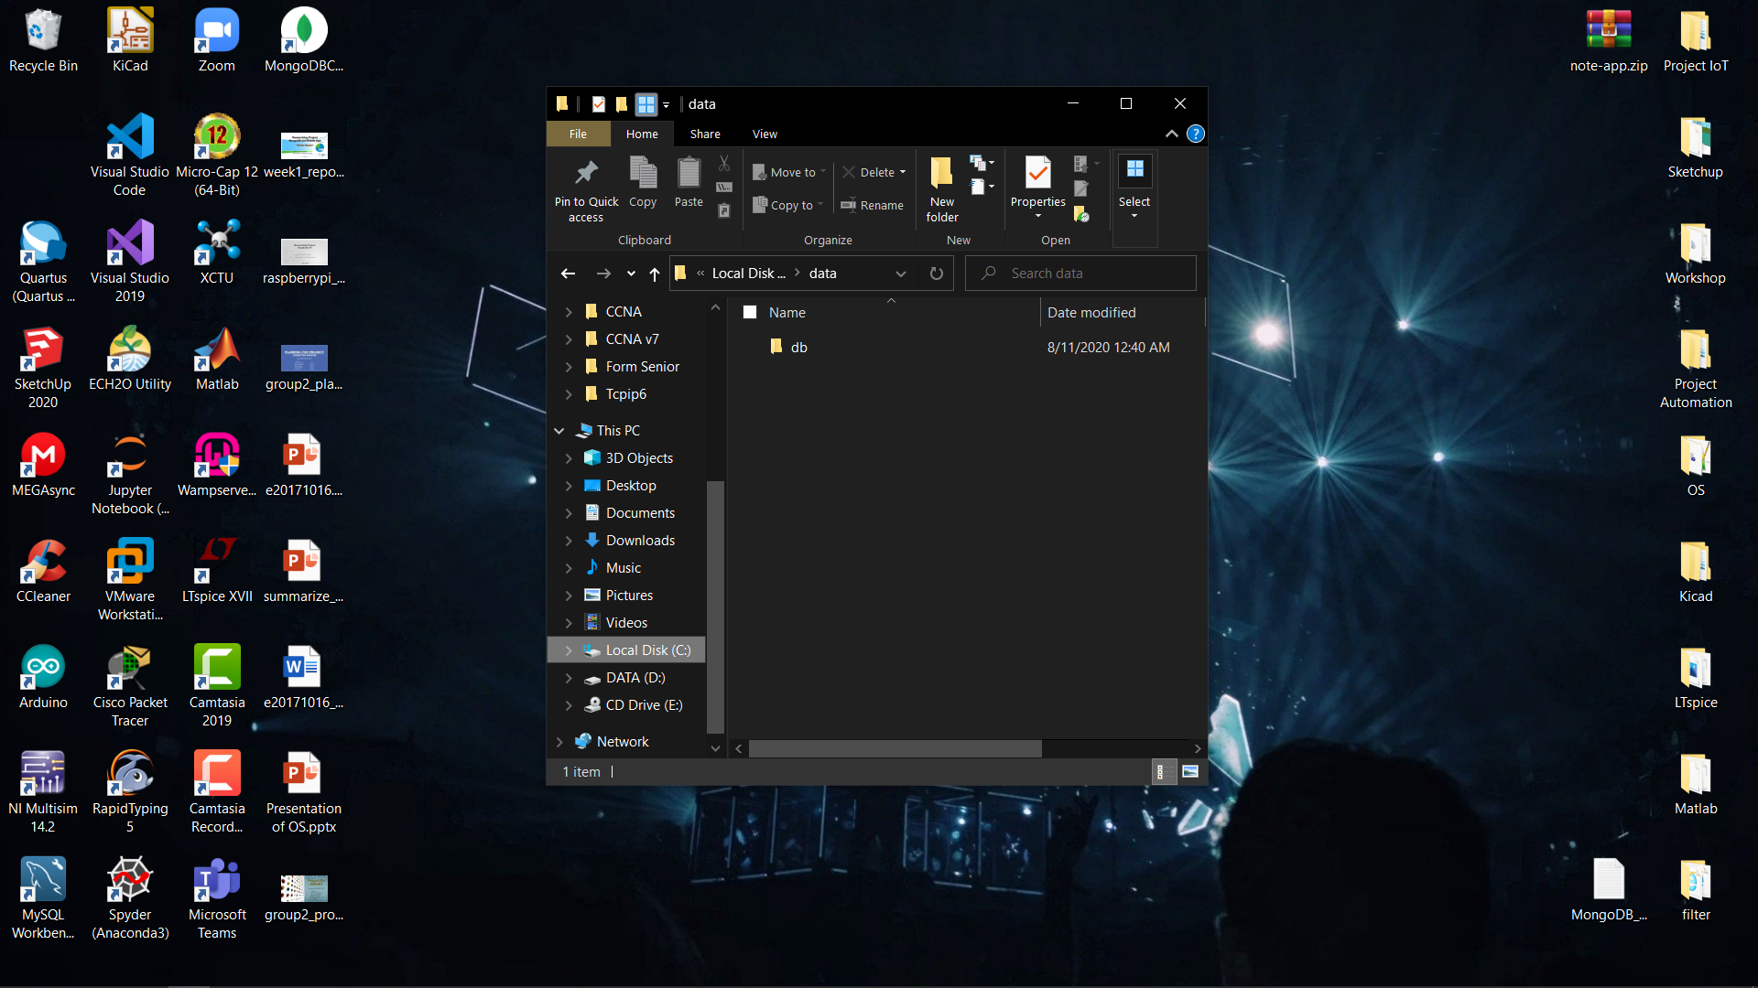
Installation MongoDB (Shell and Compass)
Stage 1
Stage 3
Stage 5
Create Folder C:\data\db
Stage 2
Stage 4
Stage 5
PAGE 04

Slide 6
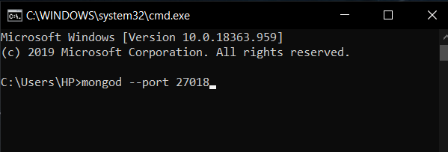
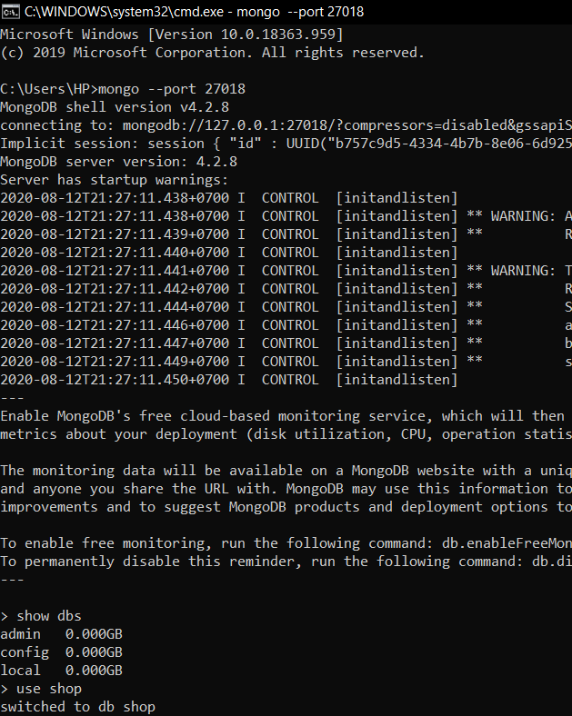
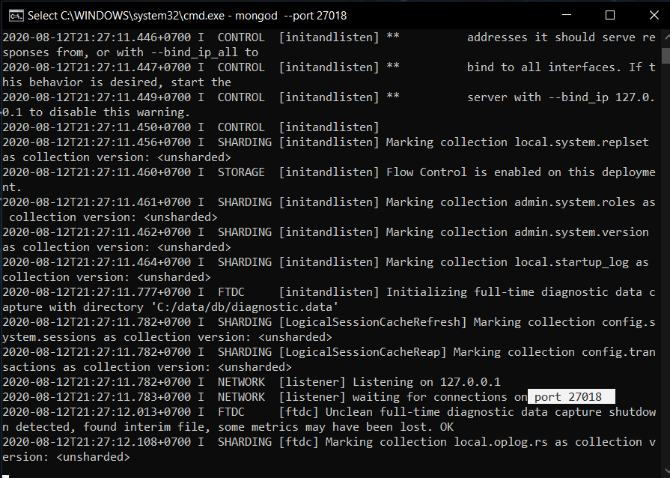
Connect localhost between Shell and Compass.(Locally)
Mongo Shell
PAGE 05

Slide 7
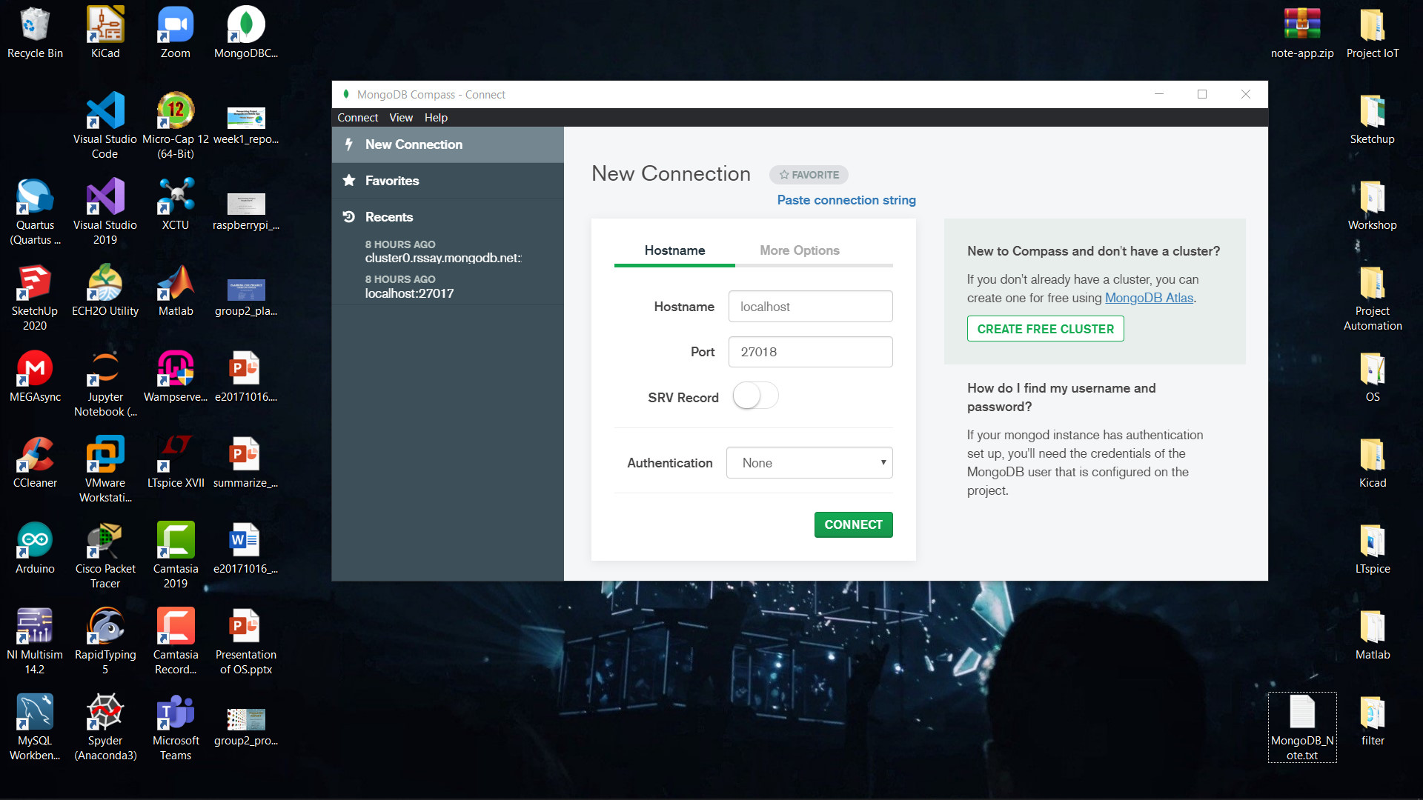
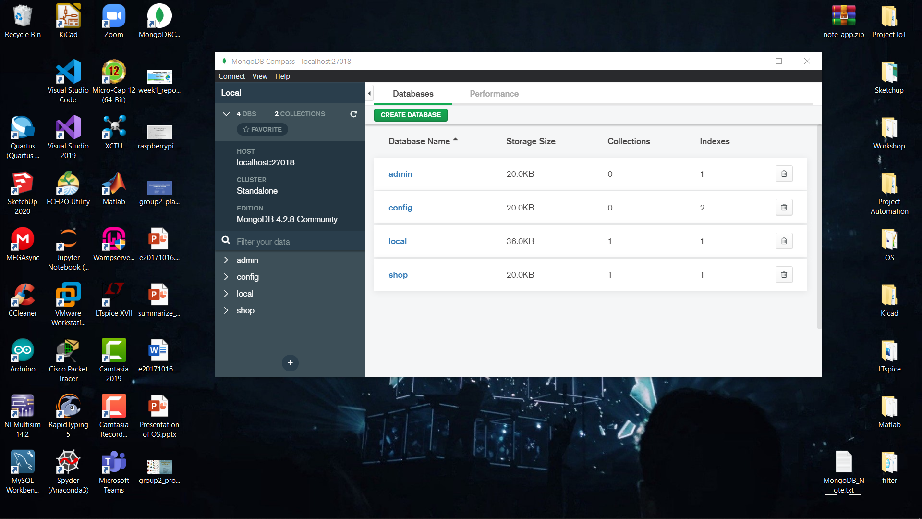
Connect localhost between Shell and Compass.(Locally)
MongoDB Compass
PAGE 06

Slide 8
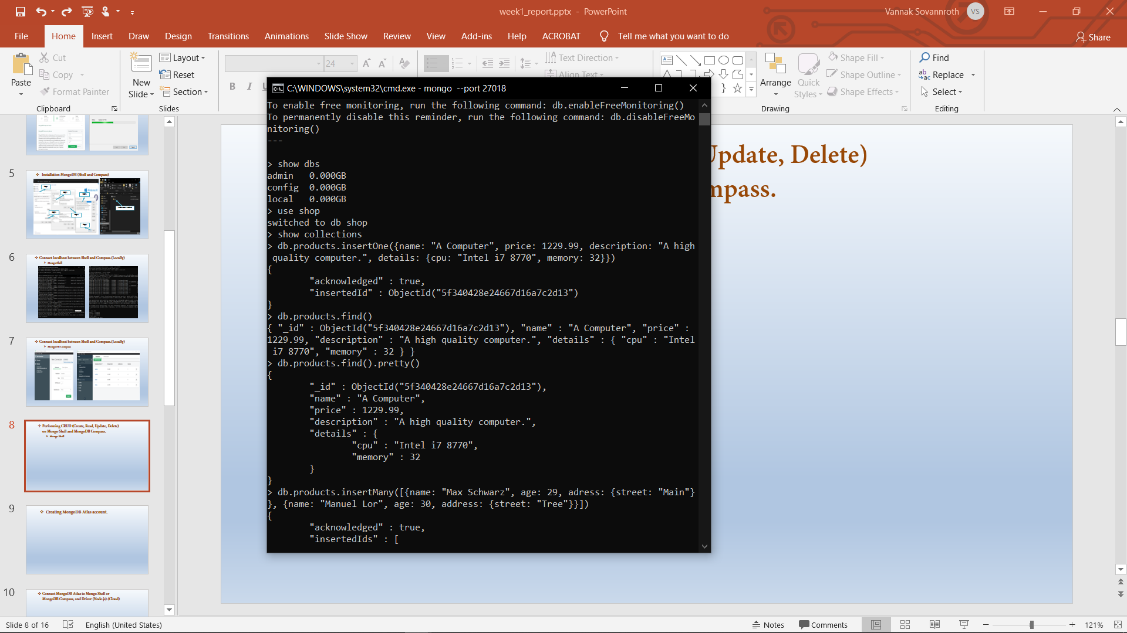
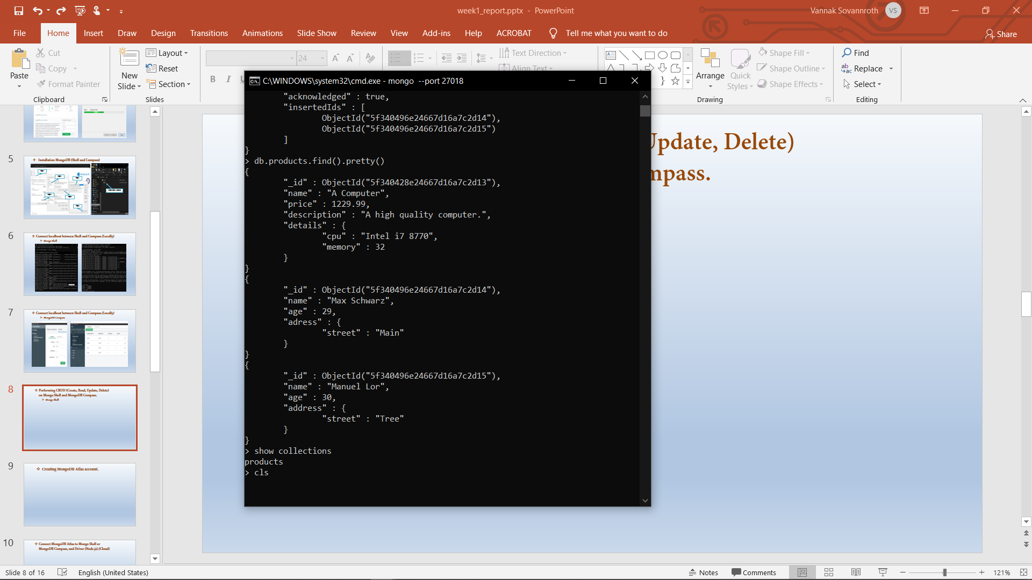
Performing CRUD (Create, Read, Update, Delete) on Mongo Shell and MongoDB Compass.
Mongo Shell
PAGE 07

Slide 9
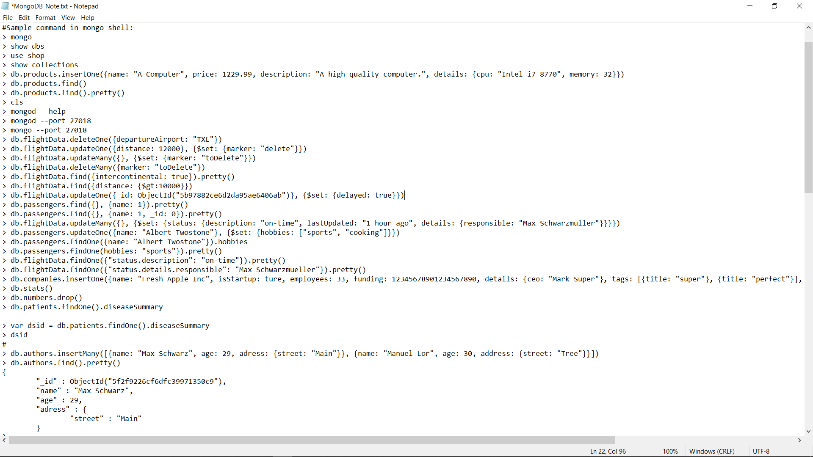
Performing CRUD (Create, Read, Update, Delete) on Mongo Shell and MongoDB Compass.
Mongo Shell
PAGE 08

Slide 10
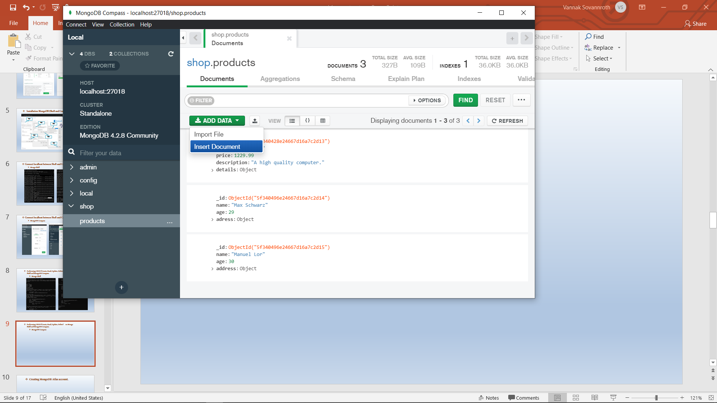
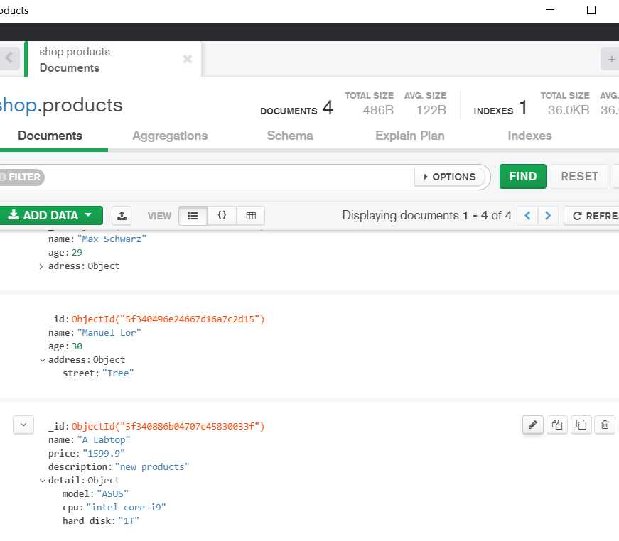
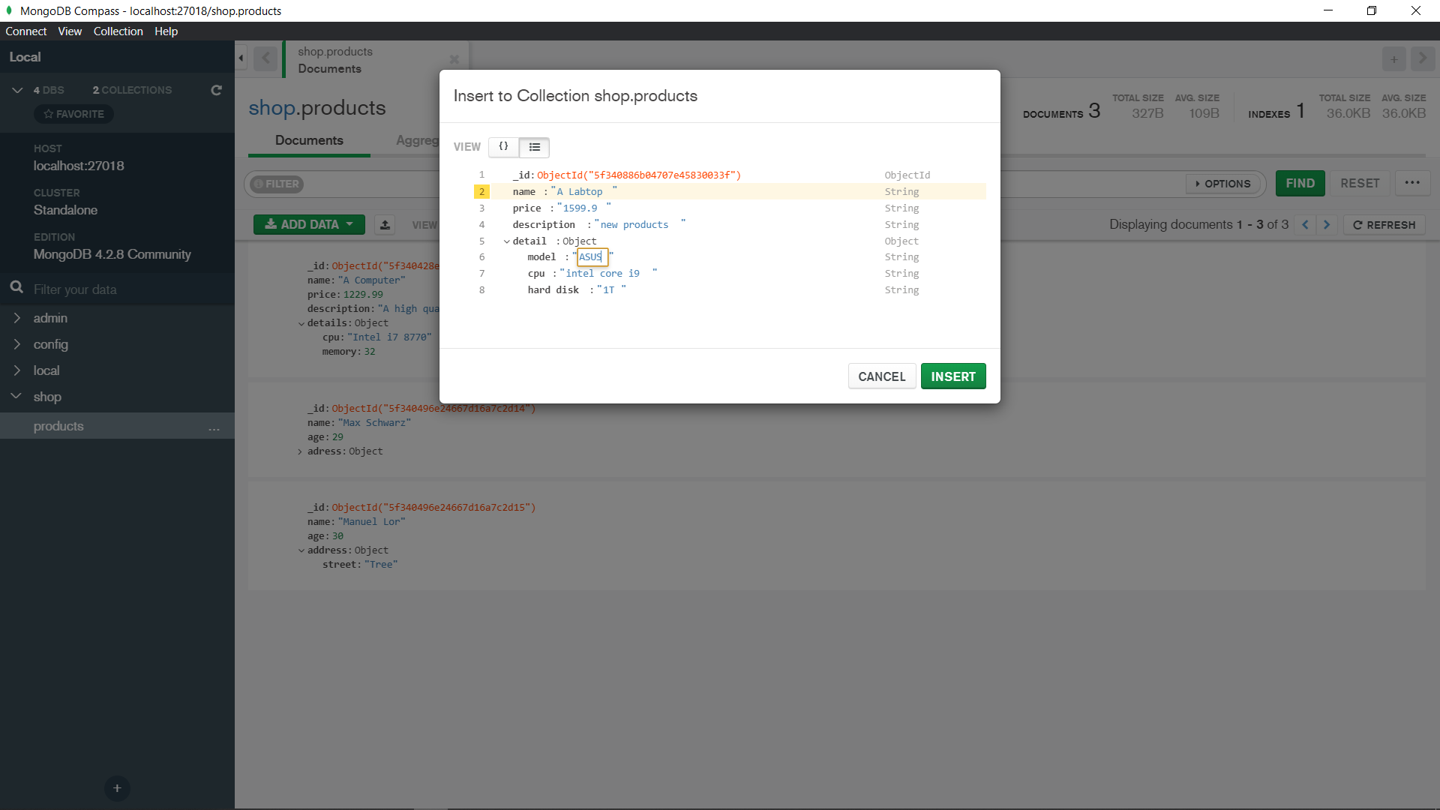
Performing CRUD (Create, Read, Update, Delete) on Mongo Shell and MongoDB Compass.
MongoDB Compass
Edit
Delete
PAGE 09

Slide 11
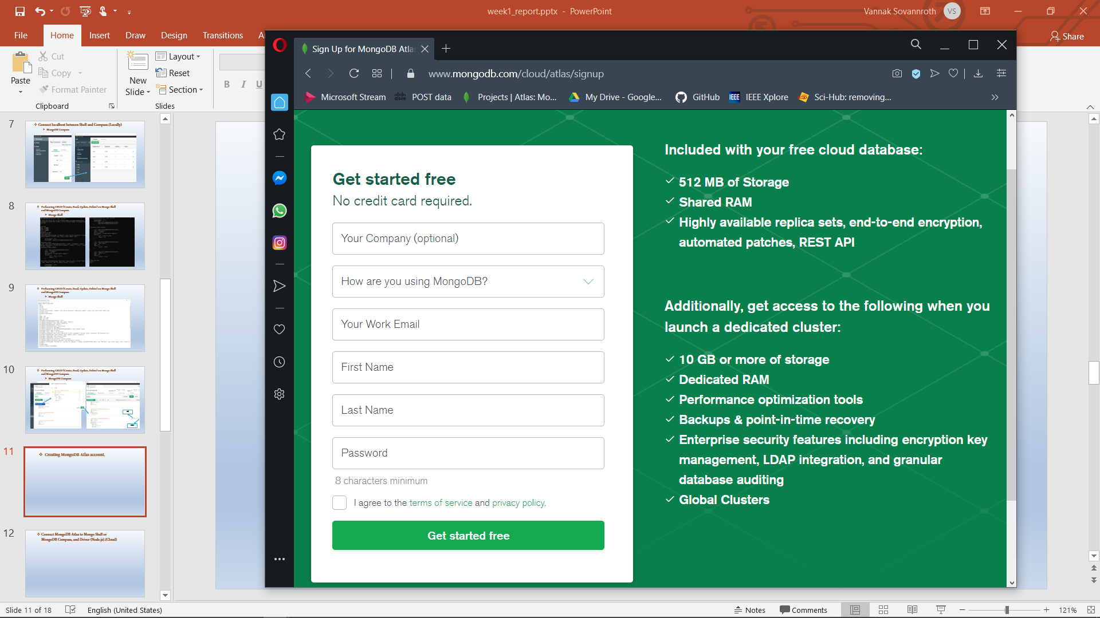
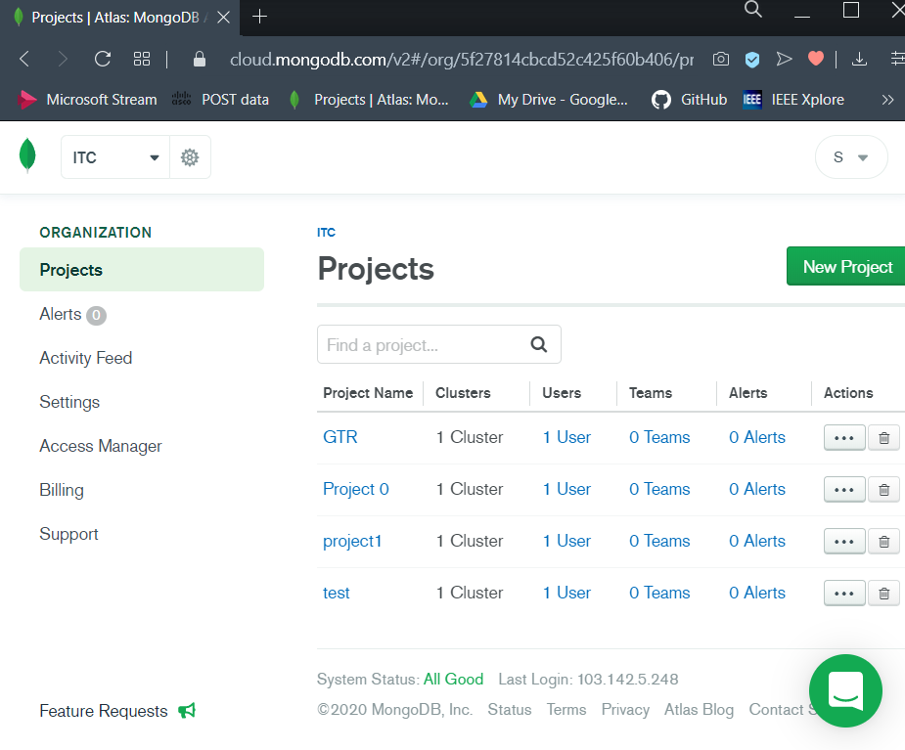
Creating MongoDB Atlas account and Projects.
PAGE 10

Slide 12
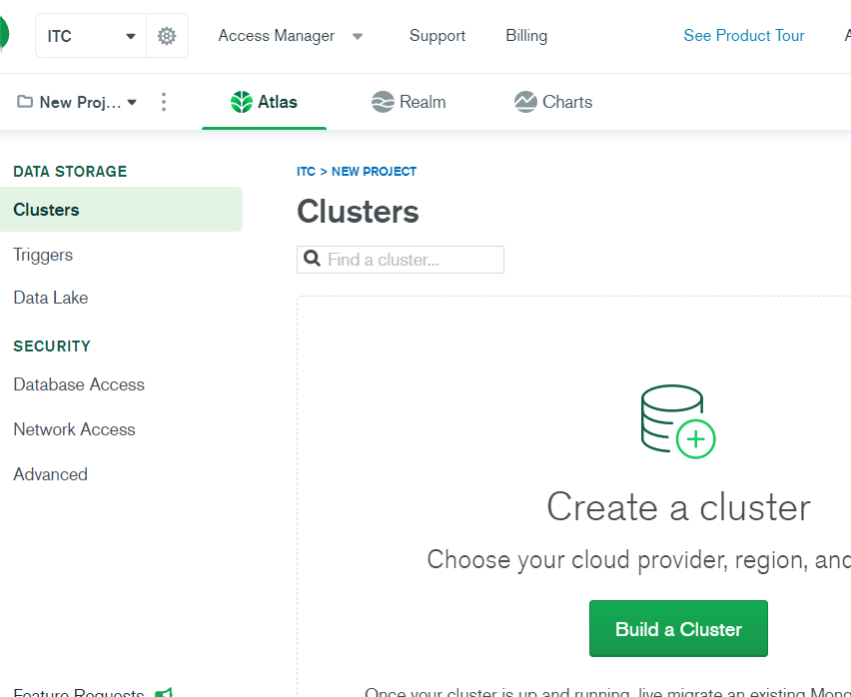
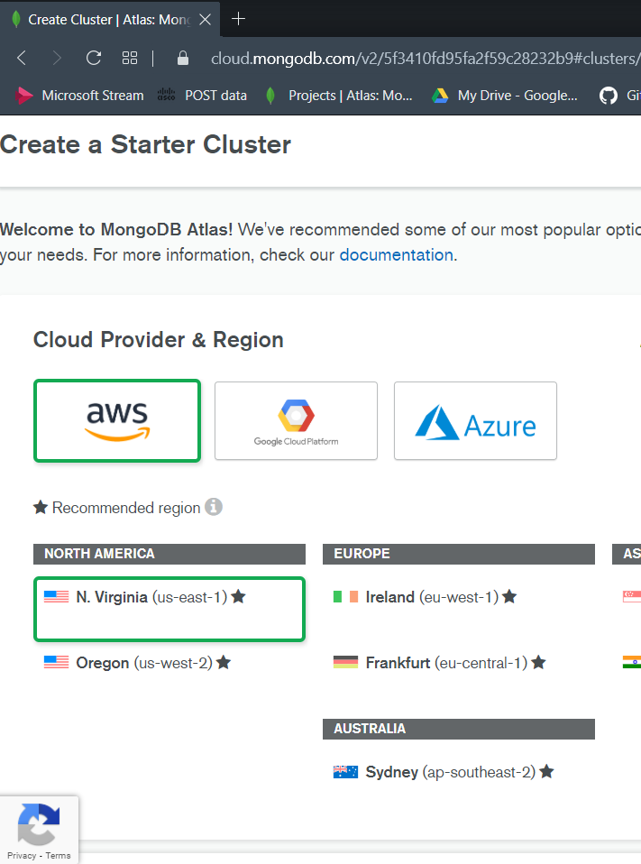
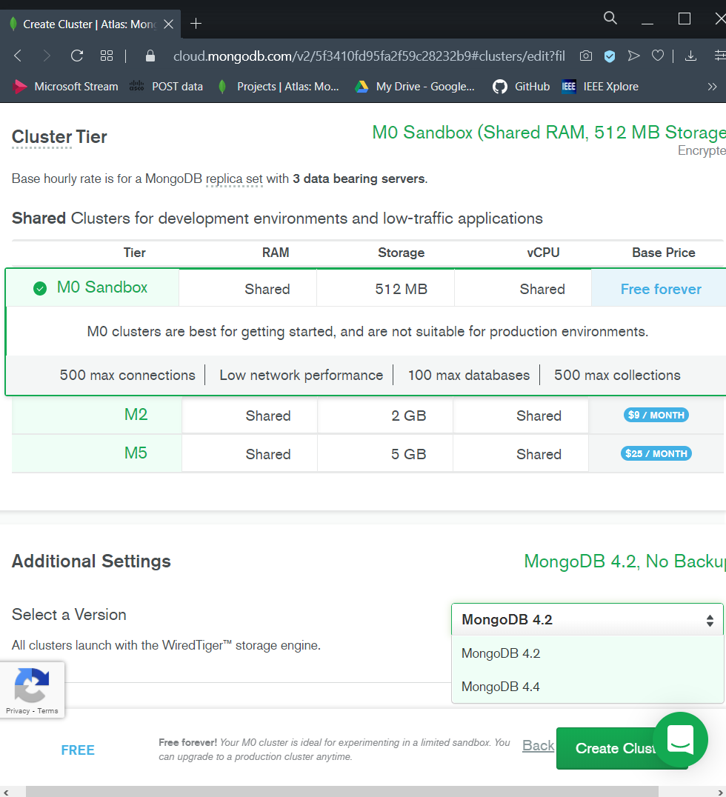
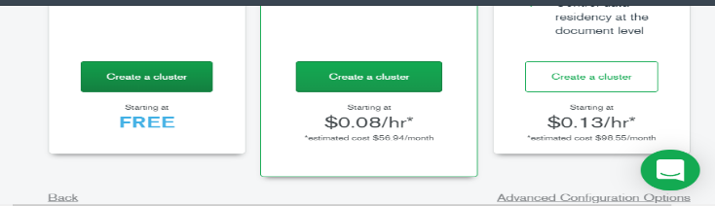
Creating MongoDB Atlas account and Projects.
Build Clusters
PAGE 11

Slide 13
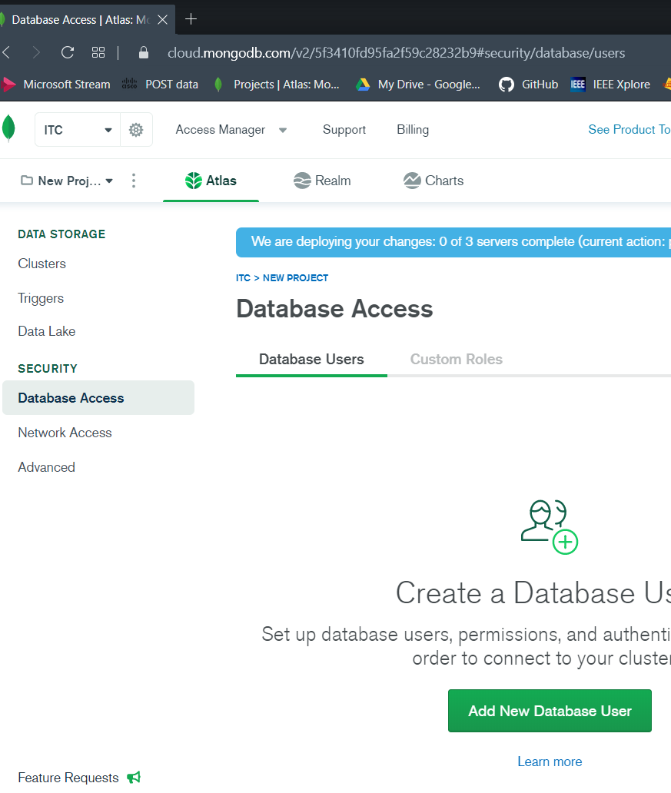
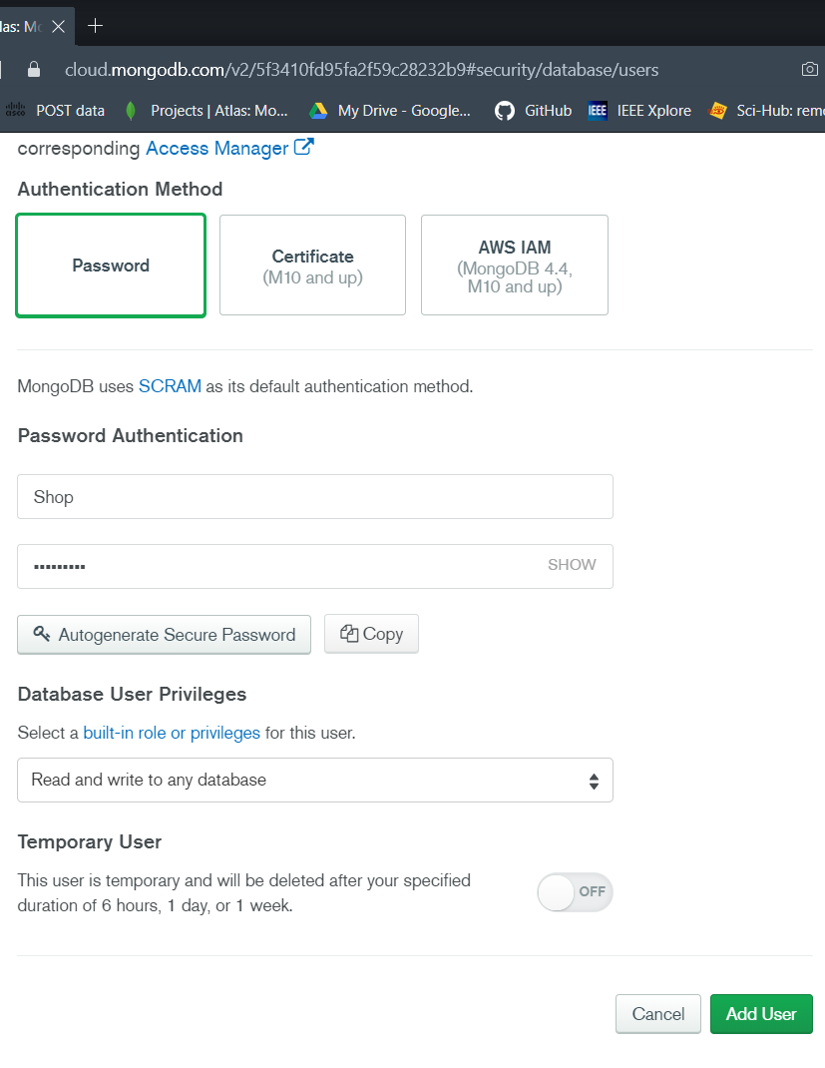
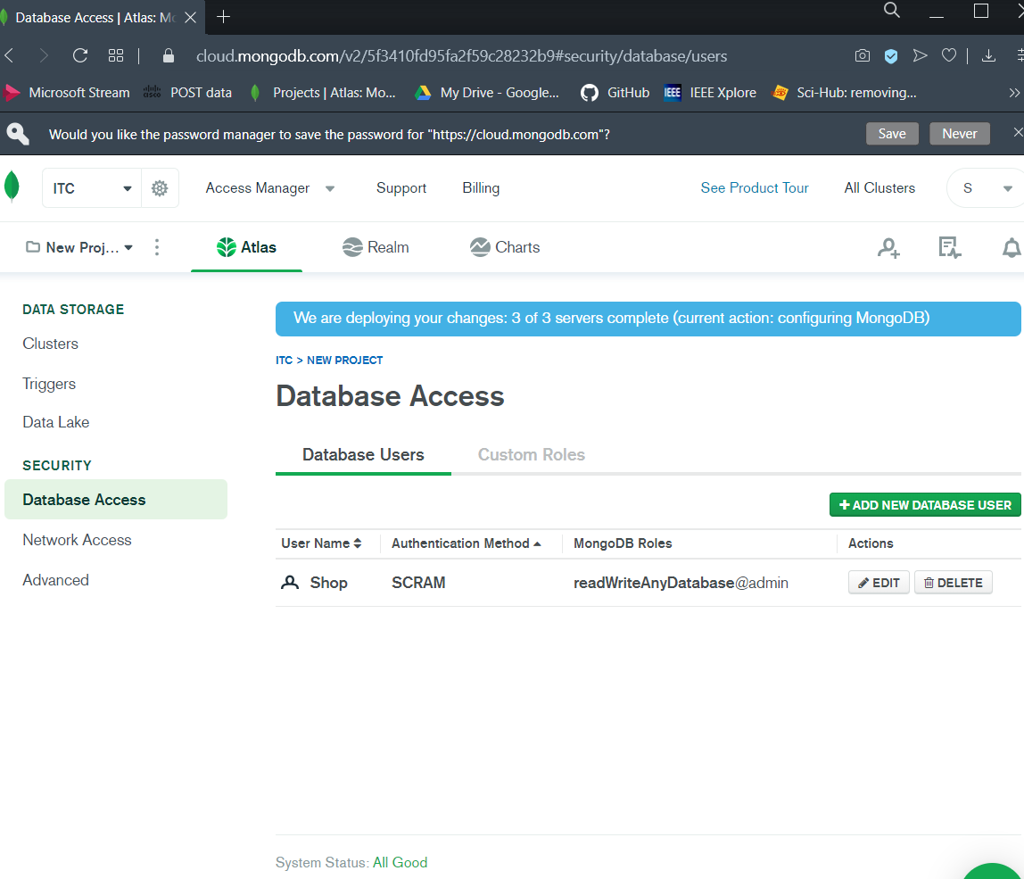
Creating MongoDB Atlas account and Projects.
Create Database User
PAGE 12

Slide 14
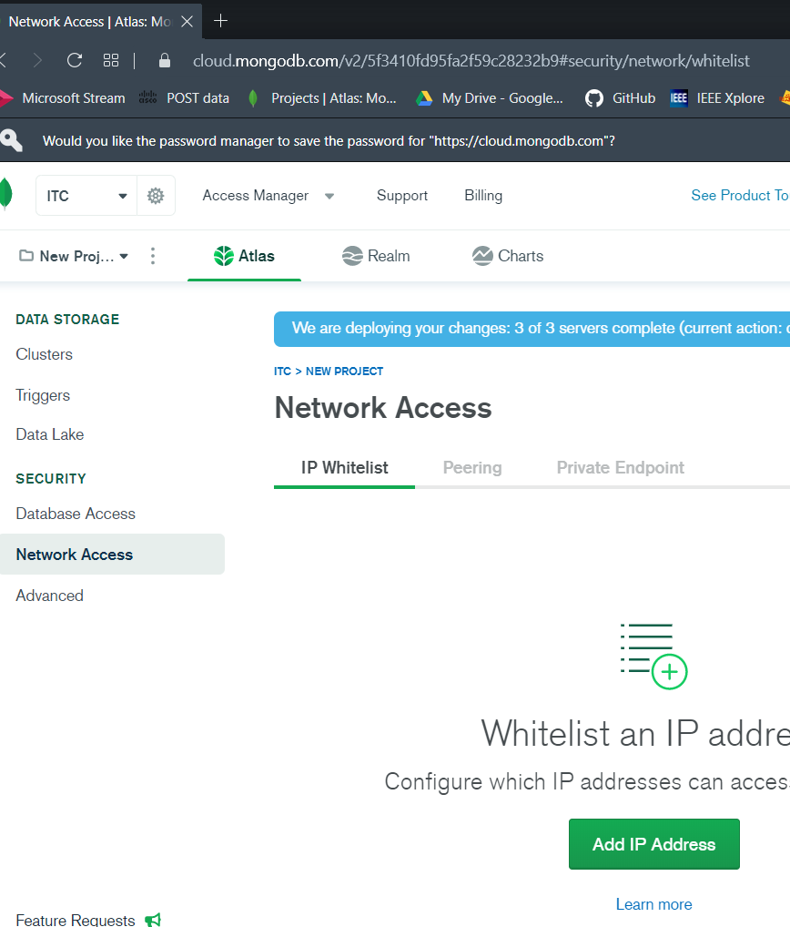
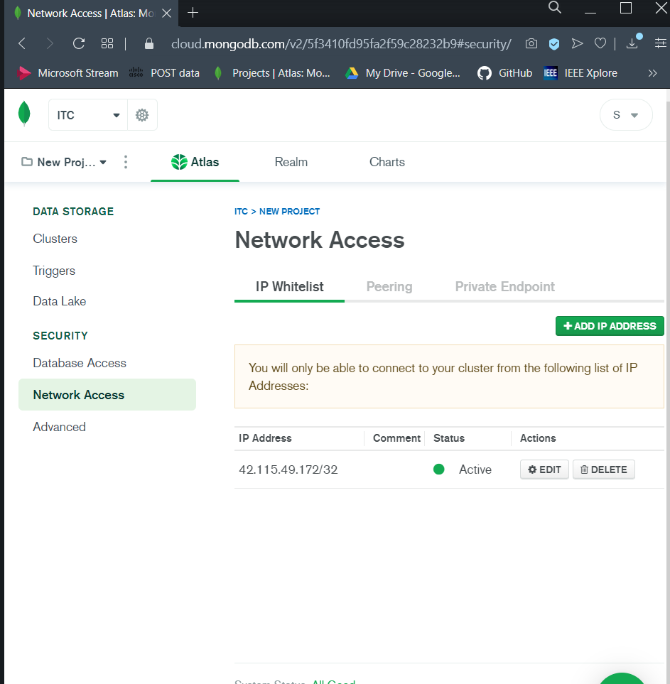
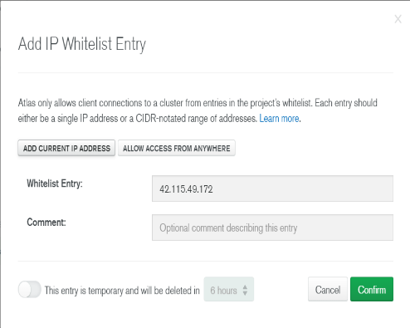
Creating MongoDB Atlas account and Projects.
Create IP address
PAGE 13

Slide 15
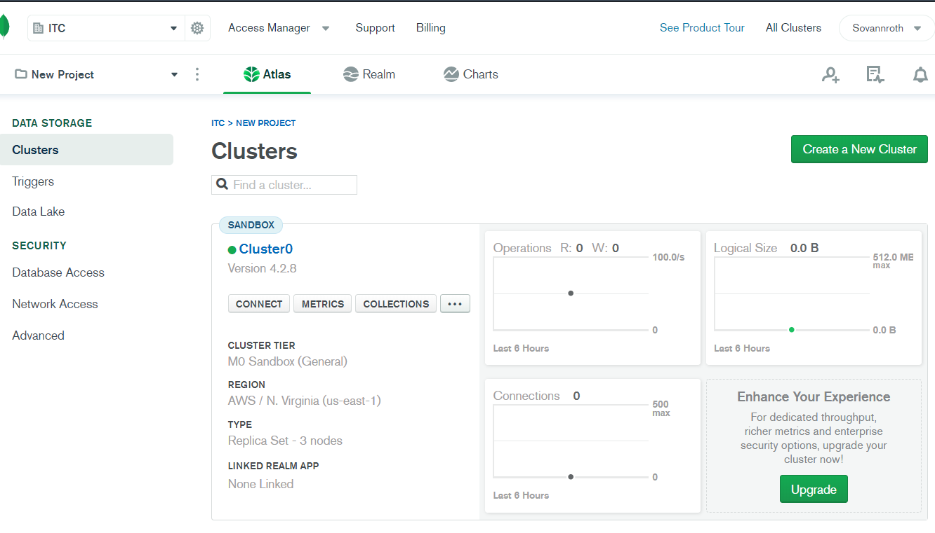
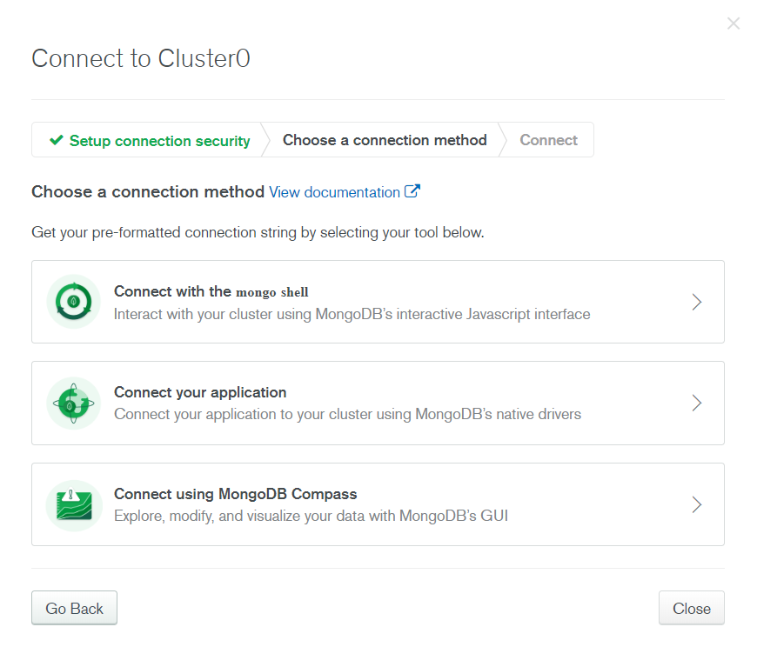
Connect MongoDB Atlas to Mongo Shell or MongoDB Compass, and Driver (Node.js).(Cloud)
Click here
PAGE 14

Slide 16
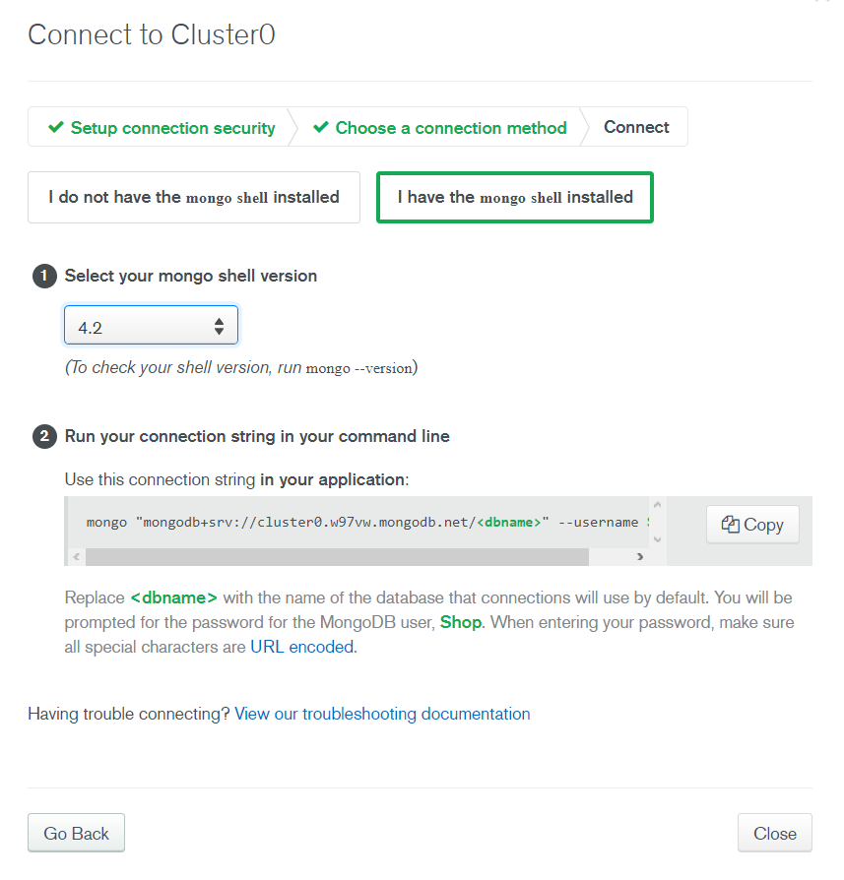
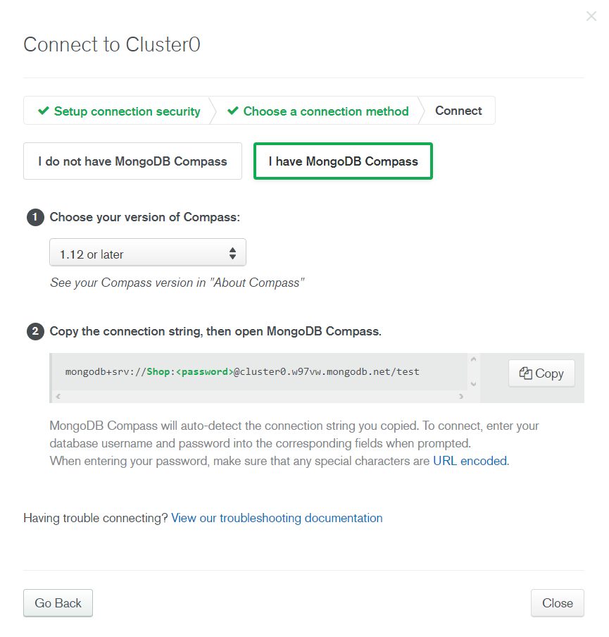
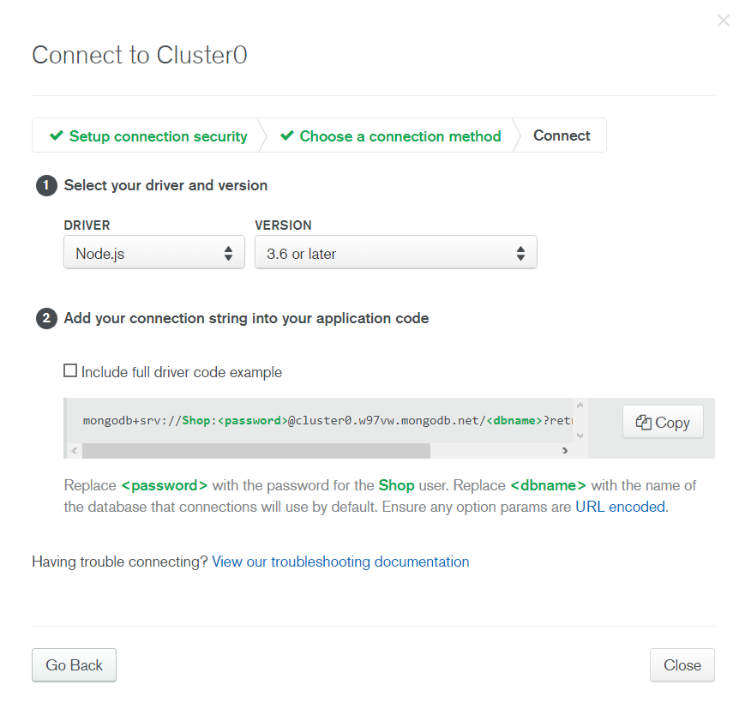
Connect MongoDB Atlas to Mongo Shell or MongoDB Compass, and Driver (Node.js).(Cloud)
PAGE 15

Slide 17
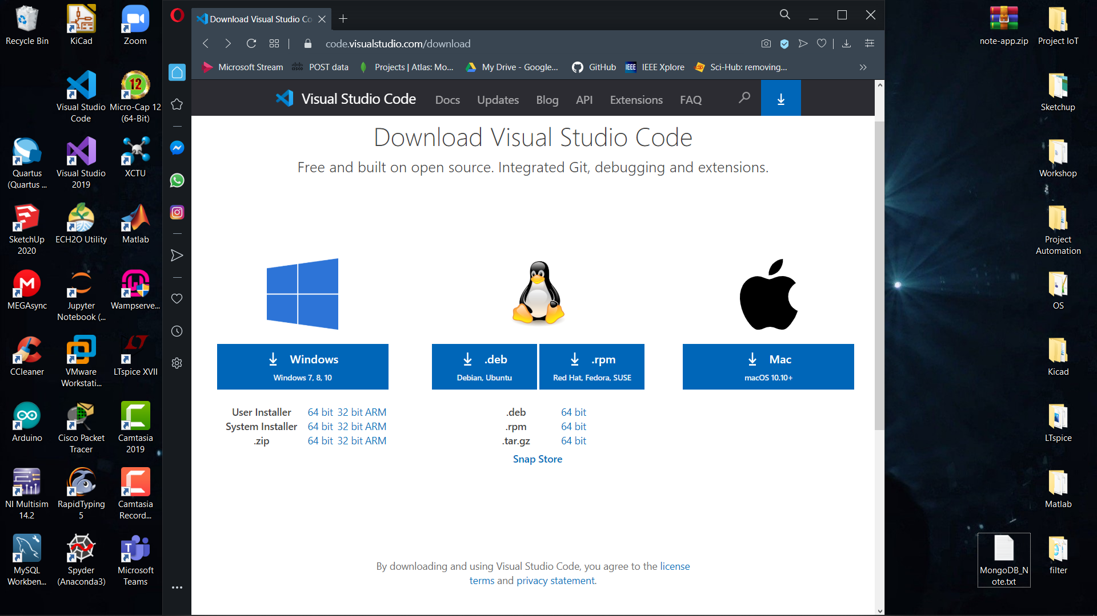
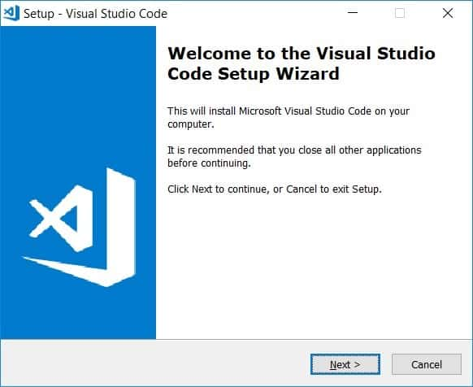
Installation Visual Studio Code
PAGE 16

Slide 18
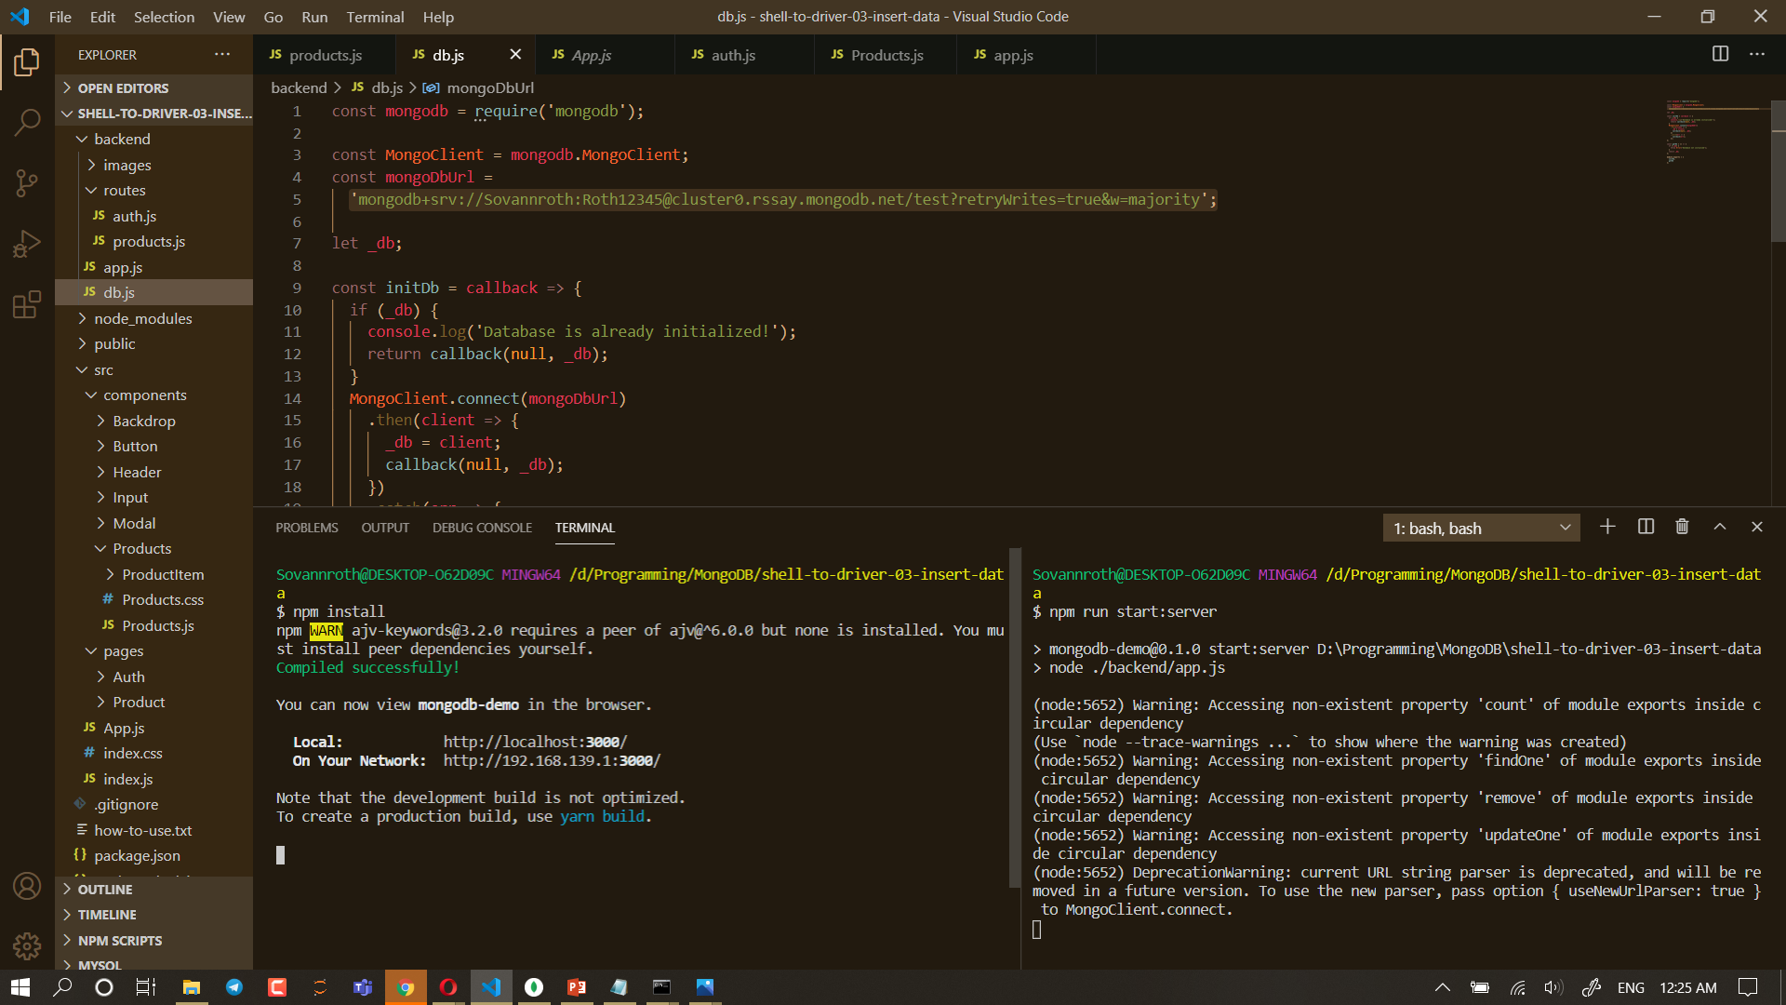
Connecting Node.js to MongoDB Cluster. (Cloud)
Code copy from MongoDB Cluster for application.
PAGE 17

Slide 19
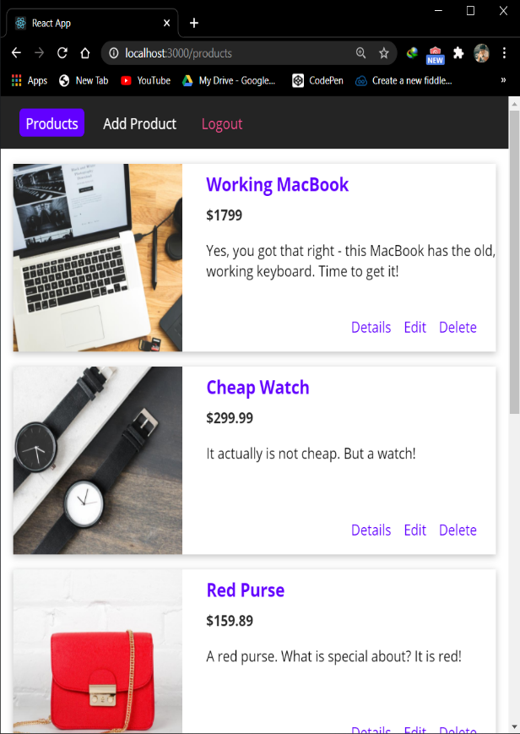
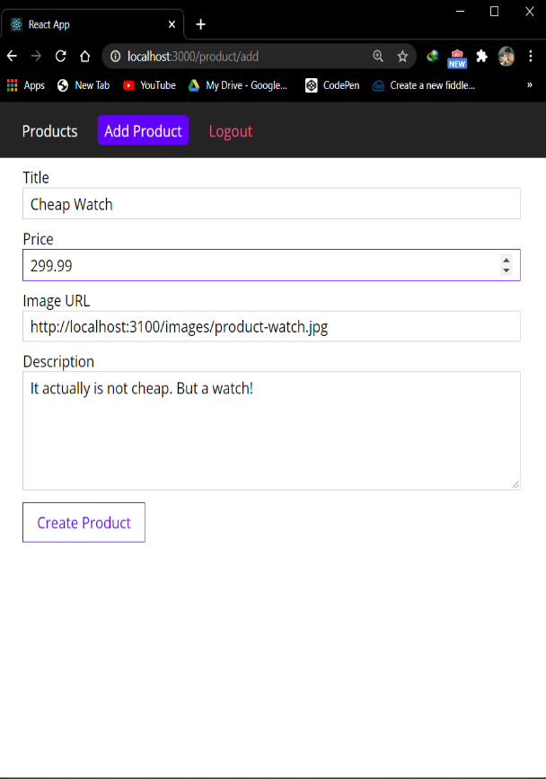
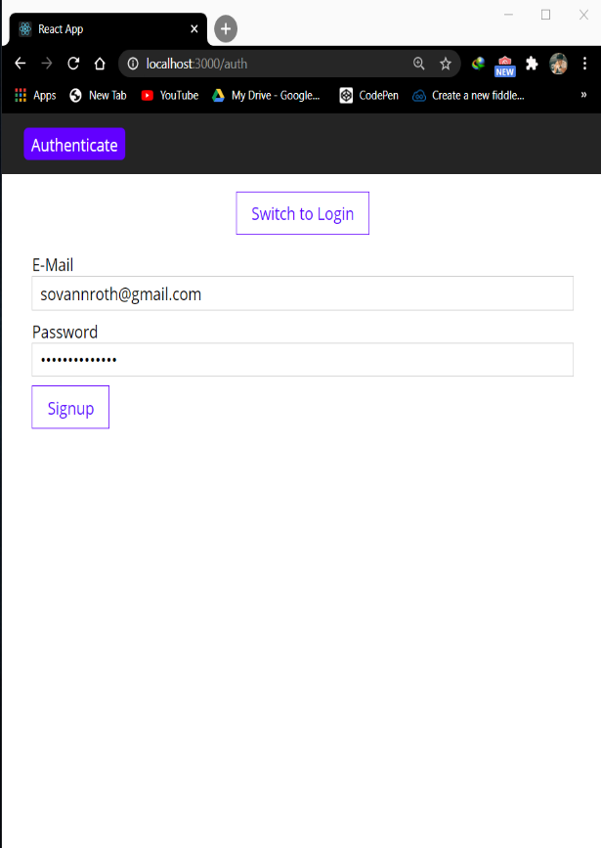
Connecting sample Backend to MongoDB Cluster and storing Products in the Database.
Sample Backend
PAGE 18

Slide 20
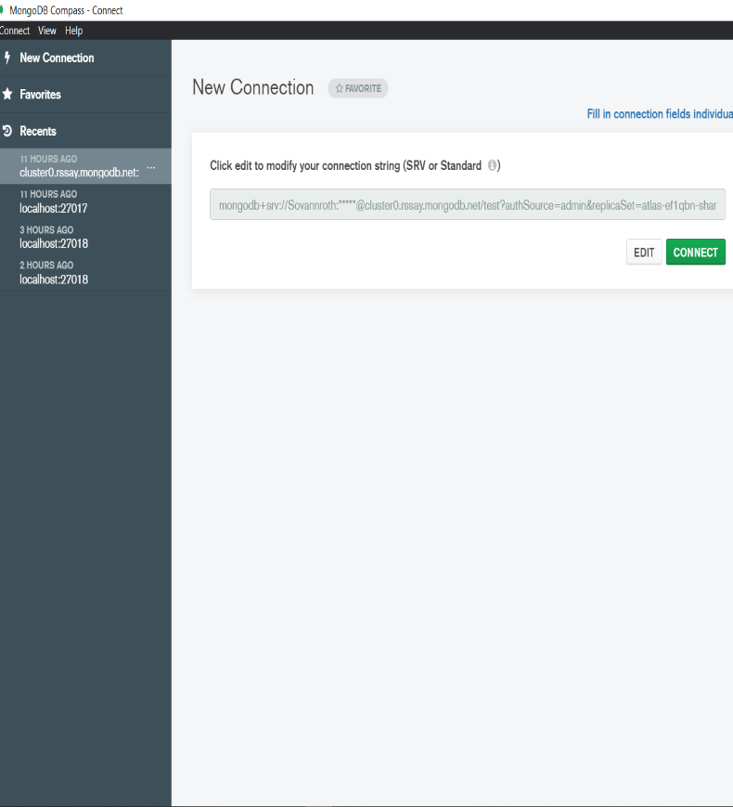
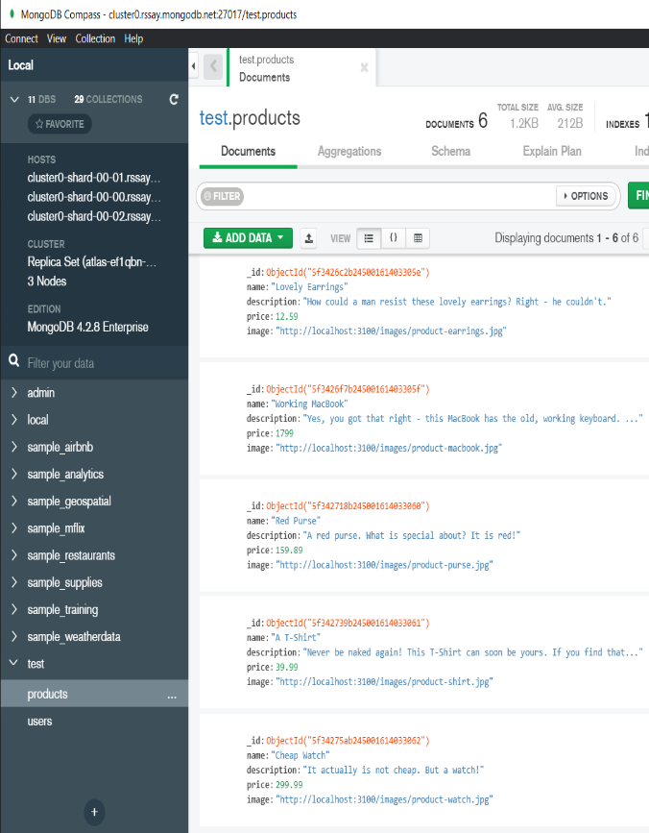
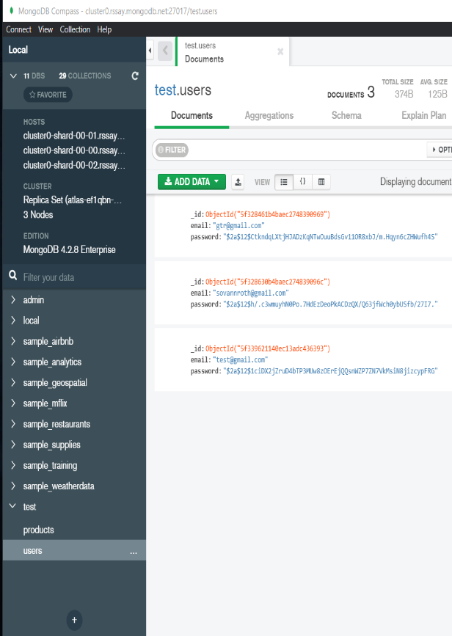
Connecting sample Backend to MongoDB Cluster and storing Products in the Database.
Storing products and users signup in the Database.
PAGE 19

Slide 21
Thank You!

